Slide 1
INVESTMENT ASSIGNMENT SUBMISSION
Name: PAVAN M REDDY
ALAP HASSAN

Slide 2
Abstract
We have been provided with the data of customers who have defaulted and those who have paid off their loans. Using this data we have to perform an analysis to predict whether the customer will default or pay their loans.
We need to find the driving factors behind loan default, i.e. the variables which are strong indicators of default.
We need to find out how these factors are interdependent or whether they are independent.

Slide 3
<Problem solving methodology>
Import Files
Plot Univariate Analysis Graphs
Pick Important Variables form Univariate Analysis
Drop Unnecessary
Columns
Univariate Analysis
Bivariate Analysis
Clean Up data.
Convert necessary
Datatypes, Remove Outliers
Categorize Necessary Continuous Variables
Plot Bivariate Analysis
Check if any columns are very highly correlated
Keep only one of the highly correlated Variables
Draw Conclusions and Predictions

Slide 4
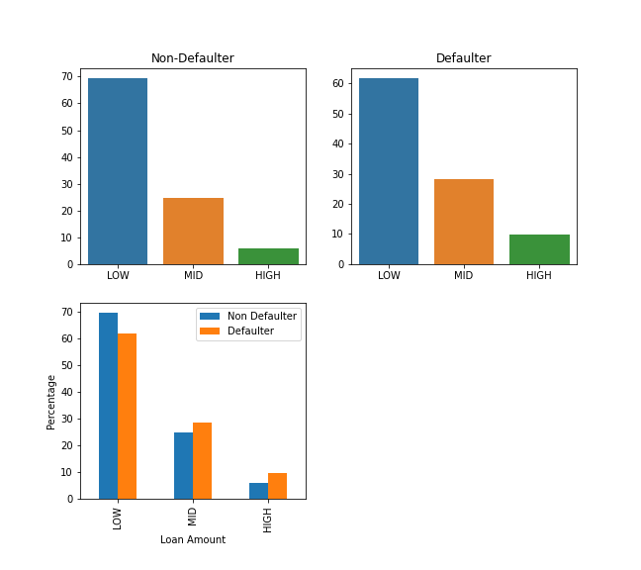
How to Read Plots
The top plots contain the normalized values(Percentages) of Defaulters and Non-Defaulters individually.
The bottom plot contains the percentage Defaulters and Non-Defaulters for a certain variable side-by-side. For Example: At Low Loan Amount, 60% of all defaulters were from Low Loan Amount and 70% of all Non-Defaulters were from Low Loan Amount

Slide 5
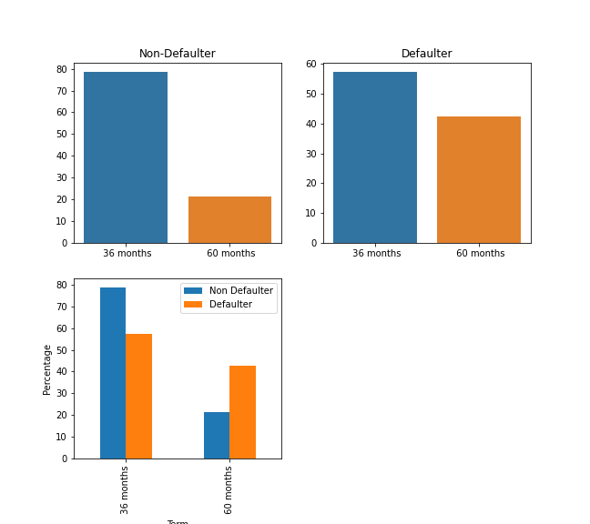
Univariate Analysis
LOW – 0-12000
MID – 12000-24000
HIGH – 24000+
Here we can see that as the loan amount increases, the likelihood of default increases
Here we can see that as the time(term) increases, the likelihood of default increases

Slide 6
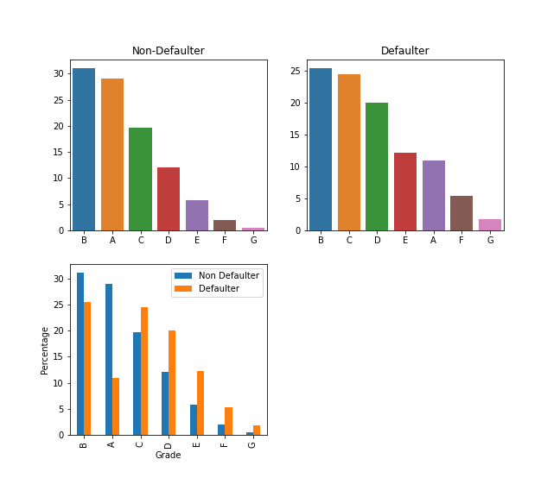
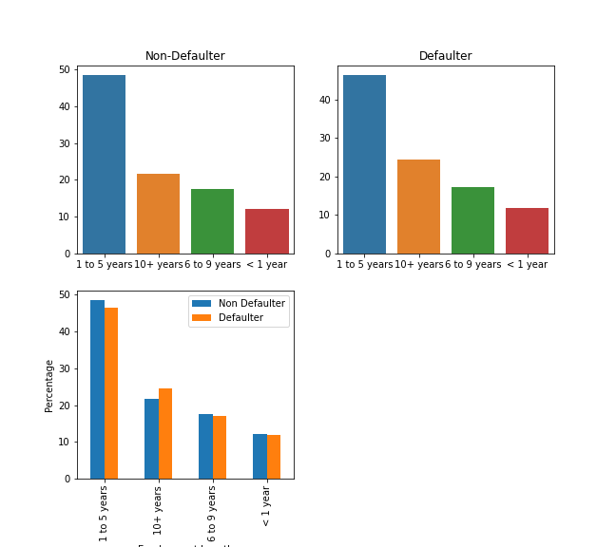
Univariate Analysis
We see an interesting observation here. People who have been employed for less than 10 years are less likely to default that those who have been employed for over 10 years
As the grade goes up, the likely hood of default increases greatly. Here, Grade A, B are the only once where the chances of default is lower than the non-default.

Slide 7
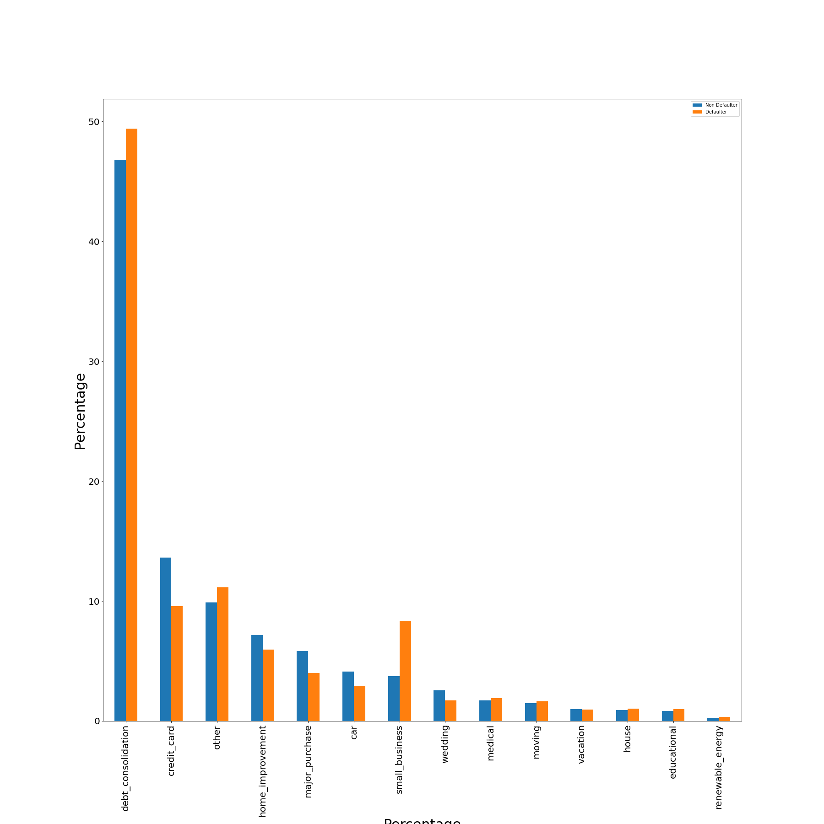
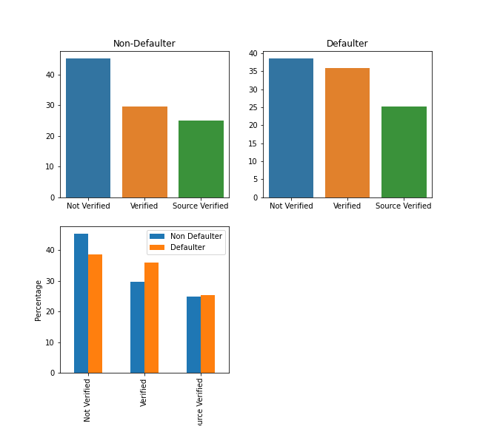
Univariate Analysis
Income sources that are not verified are less likely to default. The fact that the default rate of Verified income is higher could be due to faulty verification as the source verified does not have a significant default rate
We can see certain Purposes like Debt Consolidation, Small Business, Other have a significantly high default chance.

Slide 8
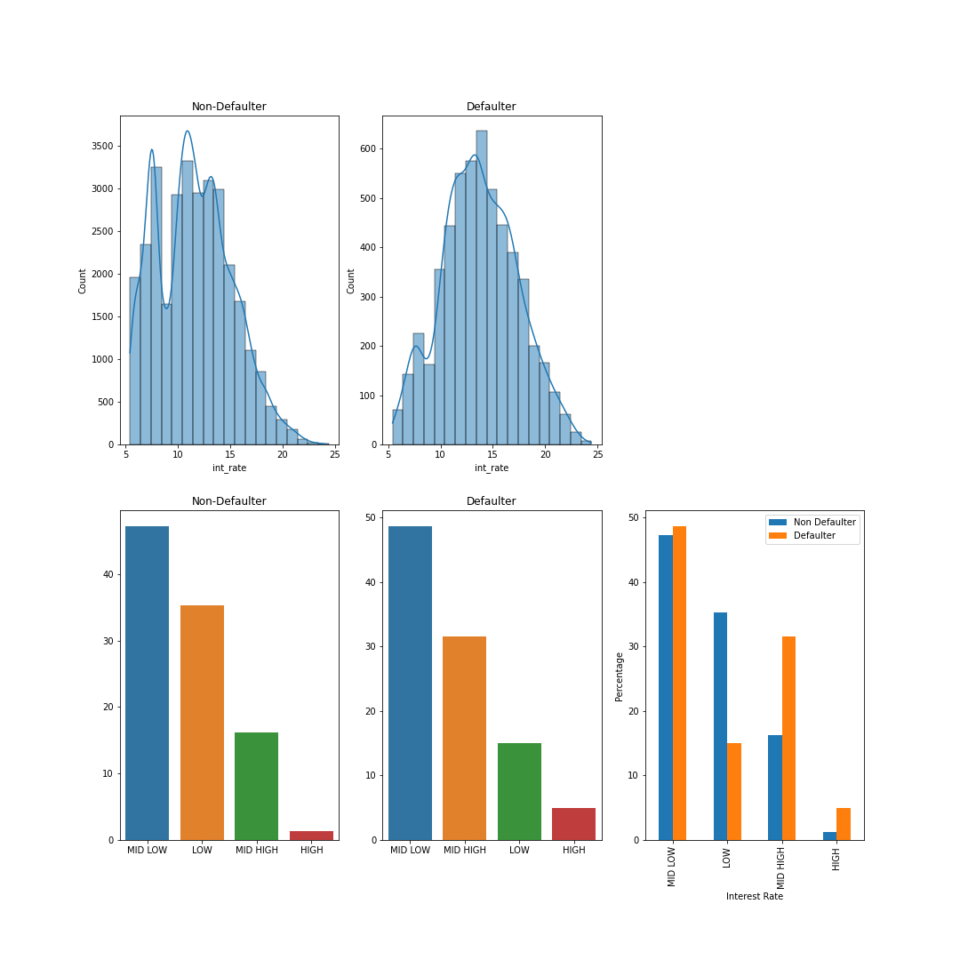
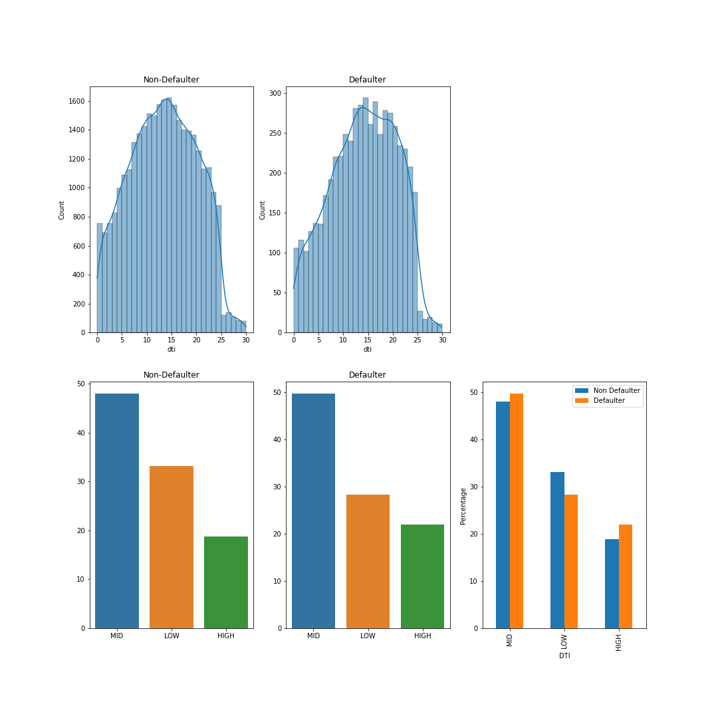
Univariate Analysis
LOW – 0-10
MID LOW – 10-15
MID HIGH – 15-20
HIGH – 20+
LOW – 0-10
MID – 10-20
HIGH – 20+
Here we can clearly see that as the interest rate increases, the chances of default increase dramatically.
People with low DTI are less likely to default.

Slide 9
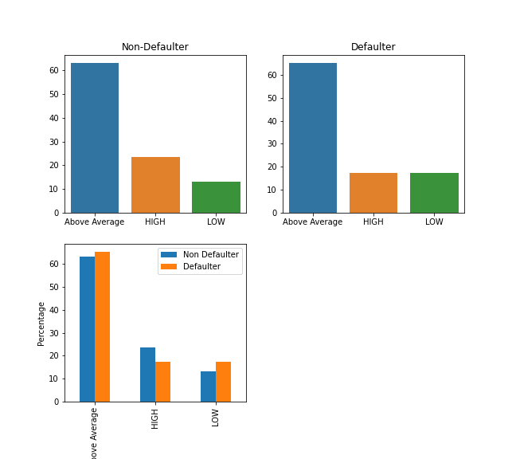
Univariate Analysis
LOW – 0-32000
Above Average – 32000-80000
HIGH – 80000+
As the income of the customer increases, the likelihood of Default decreases.

Slide 10
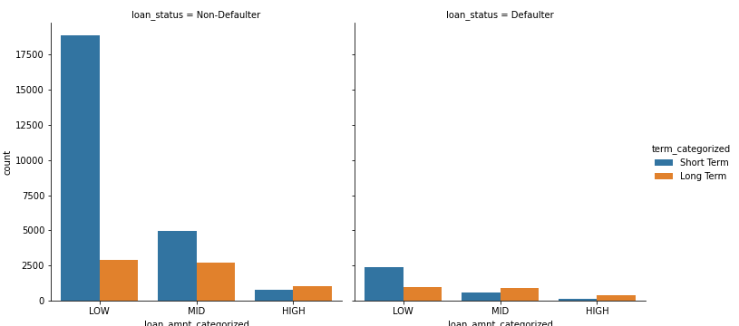
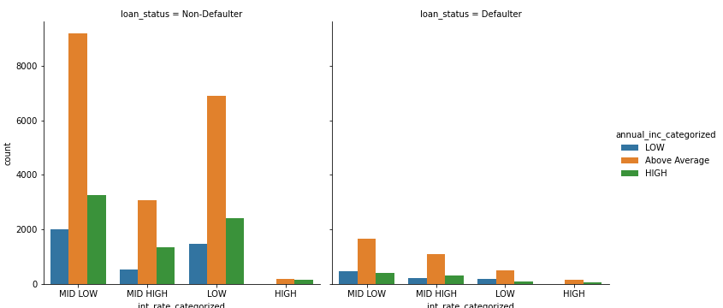
Bivariate Analysis
There is a good observation here for the mid-range loan amount. For mid range loan amount, the customer is more likey to default for a longer term(60 months) as opposed to shorter term(36 months)
People with high income are less likely to default if the interest rate is low. For Above average income and Low income, the chances of default remains the same

Slide 11
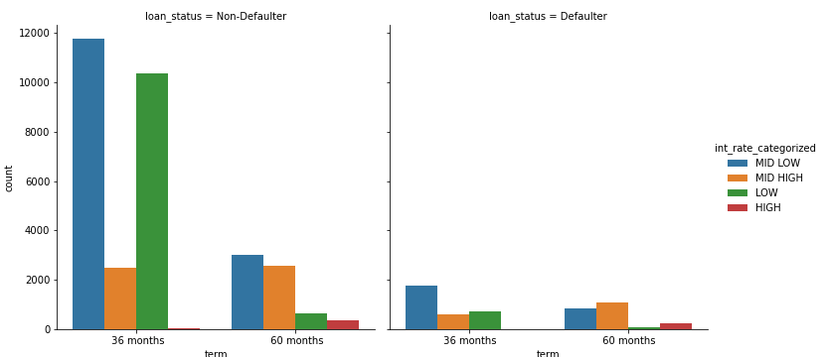
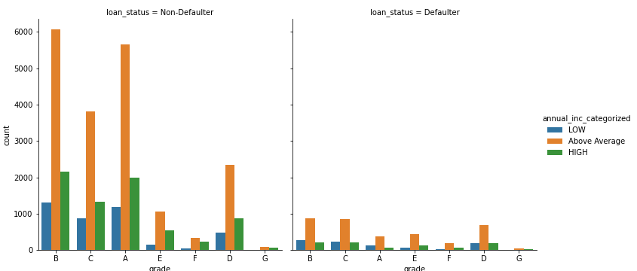
Bivariate Analysis
Here we can see that for a longer term(60 months), if the interest rate is higher(MID HIGH to HIGH), the chances of default goes up
We can see that the likely hood to default drastically decreases for high income customers when grade is A,B,C. For the rest, there is little to no change

Slide 12
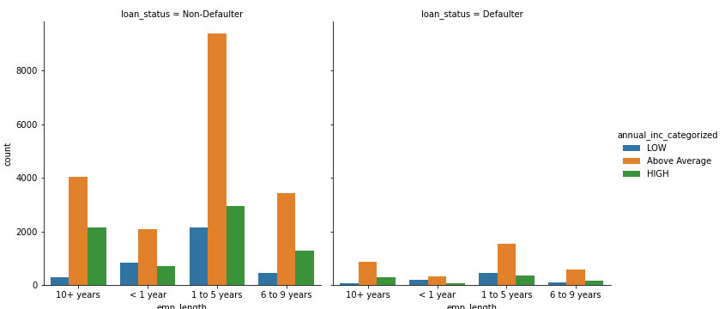
Bivariate Analysis
People with employment time of 1 to 5 years with a high annual income are less likey to default. The rest are fairly independent on annual income

Slide 13
Univariate Analysis (Other Factors)
We also took a look at many other variables such as State, Home Ownership, Sub Grade, Open Acc. and Total Acc.
Although some variables like home ownership and subgrade showed a pattern in the Univariate Analysis, they did not prove useful in Bivariate analysis. Hence, dropping them

Slide 14
CONCLUSIONS
We will split the variable into
-Customer Factors
Employment Length,
Annual Income
Verification Status
-Loan Factors
Loan Amount
Interest Rate, Term
Loan Status
Grade
We can predict whether a customer will default by analysing customer Factors against Loan Factors

Slide 15
CONCLUSIONS
Strictly Based on Univariate Analysis, we can Draw the following Conclusions
As the loan amount increases, the likelihood of default increases
For low income, the likely hood of default is very high, but for Above average income, the likelihood of default is slightly lower and for high income, the likelihood of default is significantly lower
As the time(term) increases, the likelihood of default increases
People who have been employed for less than 10 years are less likely to default that those who have been employed for over 10 years
As the grade goes up, the likely hood of default increases greately.
Income sources that are not verified are less likely to default. The fact that the default rate of Verified income is higher could be due to faulty verification as the source verified does not have a significant default rate
As the interest rate increases, the chances of default increase dramatically.
People with low DTI are less likely to default.

Slide 16
CONCLUSIONS
Based on Bivariate analysis, we can draw the following Conclusions
When an application is made, we need to look at the Loan amount, Interest Rate, Term and Grade.
-We know that for a longer term(60 months) loan, if the interest rate is higher(MID HIGH to HIGH), the chances of default goes up. Therefore providing short term loans for a higher amount.
When a high interest loan is to be given out, we can take a look at how it is depended on Annual Income
-People with high income are less likely to default if the interest rate is low. For Above average income and Low income, the chances of default remains the same.
-We can make the same type of argument for Grade, but if we take a closer look, the grade is highly correlated with interest rate. This would mean that a higher grade like G has higher interest rate.
Also looking at the customer details.
-People with employment time of 1 to 5 years with a high annual income are less likely to default. The rest are fairly independent on annual income. It would be a safer bet to pick these customers.

